Slide 1
GraphQL APIs
Lecturer: Ngo Huy Bien
Software Engineering Department
Faculty of Information Technology
VNUHCM - University of Science
Ho Chi Minh City, Vietnam
nhbien@fit.hcmus.edu.vn

Slide 2

Objectives
To create a GraphQL API.
To consume a GraphQL API.

Slide 3

Contents
REST APIs vs. GraphQL APIs
Node.js Demo (Apollo Server)
GraphQL
Node.js Demo (Mercurius)

Slide 4

References
Marc-Andre Giroux (2020). Production Ready GraphQL.
Adam D. Scott (2020). JavaScript Everywhere - Building Cross-Platform Applications with GraphQL, React, React Native, and Electron. O'Reilly Media.
Samer Buna (2021). GraphQL in Action. Manning Publications.
Thomas Hunter II (2021). Distributed Systems with Node.js. O'Reilly Media.

Slide 5
Endpoint Based APIs Clients [1]
Endpoint based APIs are great when it comes to optimizing an exchange between a client and a server for one functionality or use case.
While web browsers used to be the main clients for Web APIs, we now have to make our APIs to respond to mobile apps, other servers that are part of our distributed architectures, gaming consoles, etc.
The tricky thing is that because of that explosion in client types, for certain APIs that need to serve that many use cases, building a good endpoint to serve these scenarios became more complex.

Slide 6
Adding More Endpoints
Take an endpoint-based API that provides a way to fetch products, through a products resource.
GET /products
To provide the gaming console version of this use case, certain APIs solved the problem in the following way:
GET api/playstation/products
GET api/mobile/products
With a sufficiently large web API, you might guess what happened with this approach.
The number of endpoints used to answer variations on the same use cases exploded, which made the API extremely hard to reason about for developers, very brittle to changes, and generally a pain to maintain and evolve.

Slide 7
Adding Query Parameters
At the simplest level, this could be a very specific query parameter to select the client version we require:
GET api/products?version=gaming
GET api/products?version=mobile
Some other approaches were more generic, for example partials:
GET api/products?partial=full
GET api/products?partial=minimal
And then some others chose a more generic approach, by letting clients select what they wanted back from the server.
GET api/products?include=author&fields[products]=name,price
Some even went as far as creating a query language in a query parameter. Take a look at this example inspired by Google’s Drive API:
GET api/products?fields=name,photos(title,metadata/height)

Slide 8
Netflix's Solution
Netflix’s solution involved a new conceptual layer between the typical client and server layers, where client-specific code is hosted on the server.
In their approach, the server code takes care of “gathering content” (fetching data, calling the necessary services) while the adapter layer takes care of formatting this data in the client specific way.
In terms of developer experience, this lets the API team give back some control to client developers, letting them build their client adapters on the server.
While this might sound like just writing many custom endpoints, this architecture makes doing so much more manageable on the server.

Slide 9
SoundCloud's Solution
"So every time the apps needed a new endpoint, first the frontend team needed to convince the backend team that this was truly the case, then a story needed to be written, prioritized, picked, developed and communicated to the frontend team."
Instead of including advanced customization options to their main API, they decided that each use case would get its own API server.
This would allow developers to optimize each use case effectively without needing to worry about other use cases, which an endpoint-based API performs really well at.

Slide 10
What is GraphQL]
GraphQL is not some sort of graph database.
GraphQL is not a library.
GraphQL is not about graph theory.
GraphQL is a specification for an API query language and a server engine capable of executing such queries.

Slide 11


Slide 12
1. Create Project Structure [2]
mkdir notedly
cd notedly
mkdir api
cd api
npm init -y
mkdir src

Slide 13
2. Create src/index.js
npm install express
node src/index.js
curl http://localhost:4000
const express = require('express');
const app = express();
app.get('/', (req, res) => res.send('Hello World'));
app.listen(4000, () => console.log('Listening on port 4000!'));

Slide 14
3. Add "dev" to package.json
npm install express
npm install nodemon
npm run dev
curl http://localhost:4000
"scripts": {
"dev": "nodemon src/index.js",
"test": "echo \"Error: no test specified\" && exit 1"
},

Slide 15
4. Extend Port Options
const express = require('express');
const app = express();
const port = process.env.PORT || 4000;
app.get('/', (req, res) => res.send('Hello World!!'));
app.listen(port, () =>
console.log(`Server running at http://localhost:${port}`)
);

Slide 16
Apollo Server
Apollo Server is an open source GraphQL server library that works with a large number of Node.js server frameworks, including Express, Connect, Hapi, and Koa.
It enables us to serve data as a GraphQL API from a Node.js application and also provides helpful tooling such as the GraphQL Playground, a visual helper for working with our API in development.
https://github.com/apollographql/apollo-server

Slide 17
5. Construct a Schema
This schema will describe a single Query named hello that will return a string.
The schema is store in a variable called typeDefs.
const express = require('express');
const { ApolloServer, gql } = require('apollo-server-express');
const port = process.env.PORT || 4000;
// Construct a schema, using GraphQL schema language
const typeDefs = gql`
type Query {
hello: String
}
`;

Slide 18
6. Add a Resolver
This will be a simple function that returns the string “Hello world!”
// Provide resolver functions for our schema fields
const resolvers = {
Query: {
hello: () => 'Hello World!'
}
};

Slide 19
7. Integrate Apollo Server
const app = express();
// Apollo Server setup
const server = new ApolloServer({ typeDefs, resolvers });
server.start().then(() => {
// Apply the Apollo GraphQL middleware and set the path to /api
server.applyMiddleware({ app, path: '/api' });
app.listen({ port }, () =>
console.log(
`GraphQL Server running at http://localhost:${port}${server.graphqlPath}`
)
);
});

Slide 20
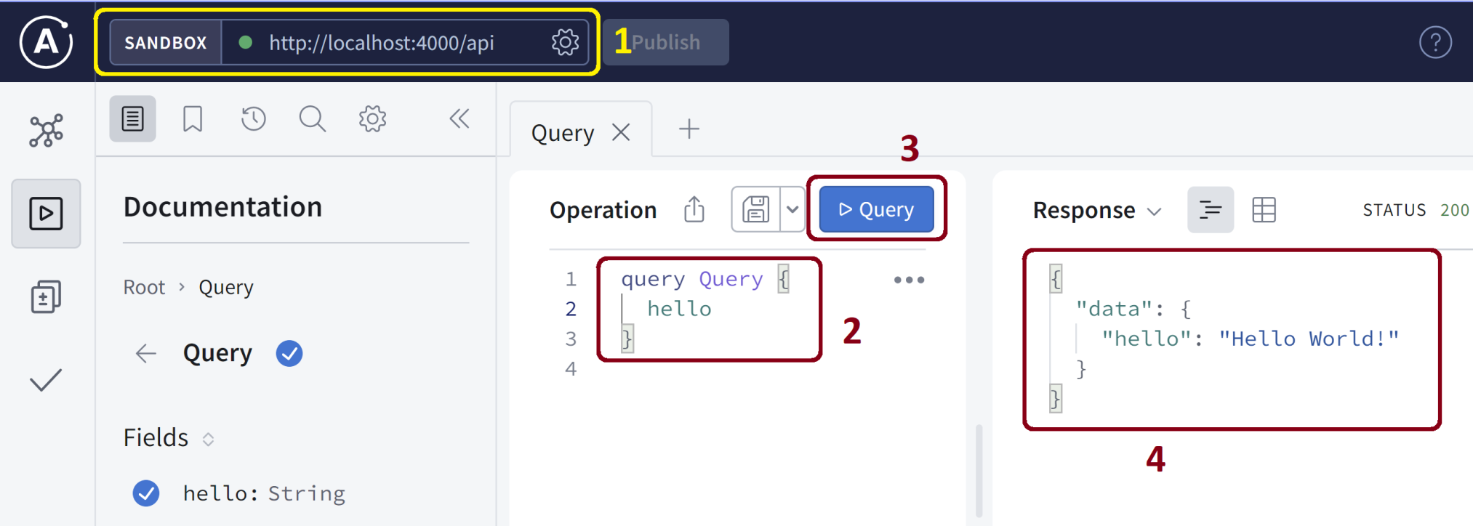
8. Hello GraphQL
npm install apollo-server-express graphql
npm run dev
Open http://localhost:4000/api using a browser.

Slide 22
What is GraphQL? [3]
The word graph in GraphQL comes from the fact that the best way to represent data in the real world is with a graph-like data structure.
If you analyze any data model, big or small, you’ll always find it to be a graph of objects with many relations between them.
GraphQL is a query language for data APIs, but that’s only from the perspective of the frontend consumer of those data APIs.
GraphQL is also a runtime layer that needs to be implemented on the backend, and that layer is what makes the frontend consumer able to use the new language.

Slide 23
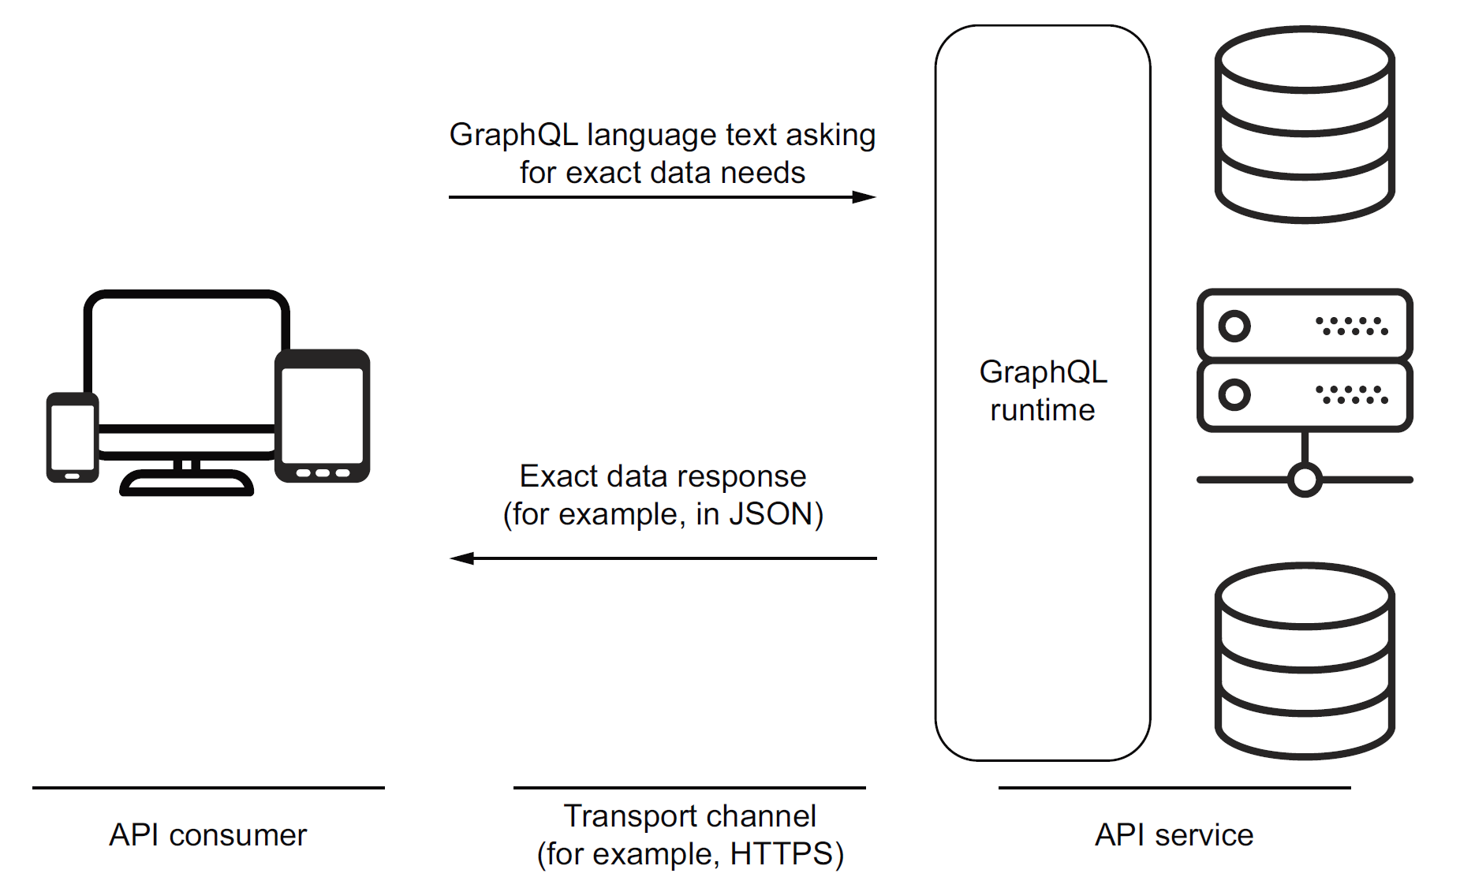
GraphQL is a Language and a Runtime

Slide 24
GraphQL APIs vs. REST APIs
Unlike REST where you might need to have several endpoints to get you the data you need, GraphQL exposes only a single endpoint.
REST works on Http only while GraphQL doesn’t need Http to work.
Unlike REST where you can use any Http verb, GraphQL recommends using only the Http POST verb.
Unlike REST where the request and response are defined by the API, the clients or the consumers of GraphQL can define what data they need. While the size of the resource is determined by the server when working with REST, in GraphQL, the API defines the available resources, and the client requests only what it needs.
Both REST and GraphQL are platform and language agnostic, and both are adept at returning JSON.

Slide 25
REST vs. GraphQL: starwars-data.json
{
"data": {
"person": {
"name": "Darth Vader",
"birthYear": "41.9BBY",
"planet": {
"name": "Tatooine"
},
"films": [
{
"title": "A New Hope"
},
{
"title": "The Empire Strikes Back"
},
{
"title": "Return of the Jedi"
},
{
"title": "Revenge of the Sith"
}
]
}
}
}
REST:
GET - /people/{id}
GET - /people/{id}/films
GraphQL:
GET or POST - /graphql?query={·-·-·}

Slide 26
GraphQL Problems
A critical threat for GraphQL APIs is resource-exhaustion attacks (aka denial-of-service attacks). A GraphQL server can be attacked with overly complex queries that consume all the server resources.
One task that GraphQL makes a bit more challenging is clients’ caching of data. Responses from REST APIs are a lot easier to cache because of their dictionary nature. A specific URL gives certain data, so you can use the URL itself as the cache key.
A developer writing a GraphQL-based frontend application has to learn the syntax of the GraphQL language. A developer implementing a GraphQL backend service has to learn a lot more than just the language: they have to learn the API syntax of a GraphQL implementation. They must also understand schemas and resolvers, among many other concepts specific to a GraphQL runtime.

Slide 27
GraphQL is a Language
GraphQL can be used for both reading and modifying data.
When you need to read data with GraphQL, you use queries; and when you need to modify data, you use mutations.
GraphQL operations:
Queries represent READ operations.
Mutations represent WRITE-then-READ operations. You can think of mutations as queries that have side effects.
GraphQL also supports a third request type called a subscription, used for real-time data monitoring requests. Subscriptions represent continuous READ operations.
GraphQL subscriptions require the use of a data-transport channel that supports continuous pushing of data. That’s usually done with WebSockets for web applications.

Slide 28
The GraphQL Language
To ask any GraphQL server for data, we send it a request written in the GraphQL query language.
The source text of a GraphQL request is often referred to as a document.
A document contains text that represents a request through operations like queries, mutations, and subscriptions.
In addition to the main operations, a GraphQL document text can contain fragments that can be used to compose other operations.
A GraphQL request can also contain an object representing values of variables that may be used in the request document text.
The request may also include meta-information about operations. For example, if the request document contains more than one operation, a GraphQL request must include information about which operation to execute.

Slide 29
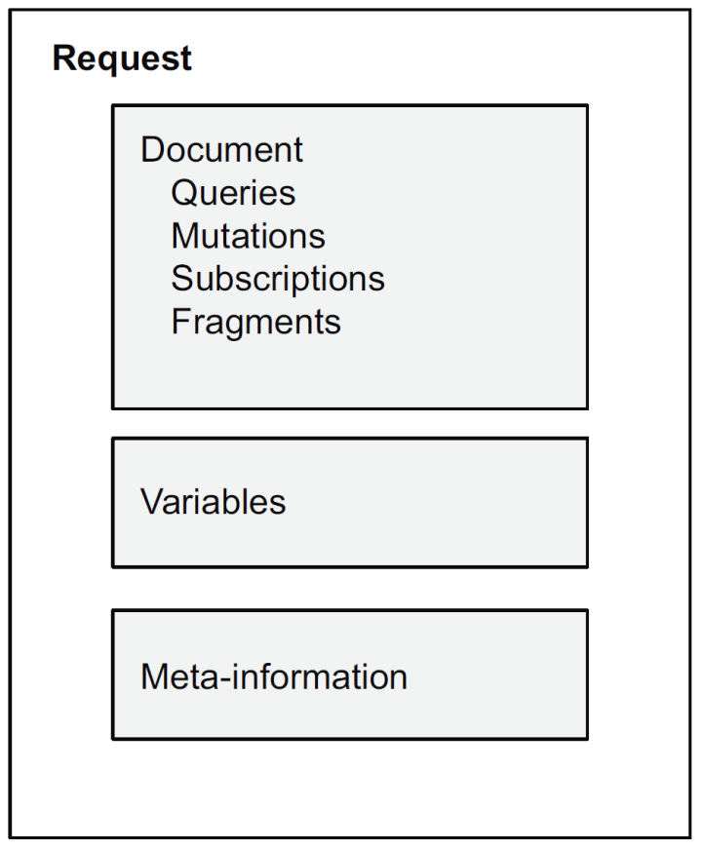
Example Request Document
query GetEmployees($active: Boolean!) {
allEmployees(active: $active) {
...employeeInfo
}
}
query FindEmployee {
employee(id: $employeeId) {
...employeeInfo
}
}
fragment employeeInfo on Employee {
name
email
startDate
}

Slide 31
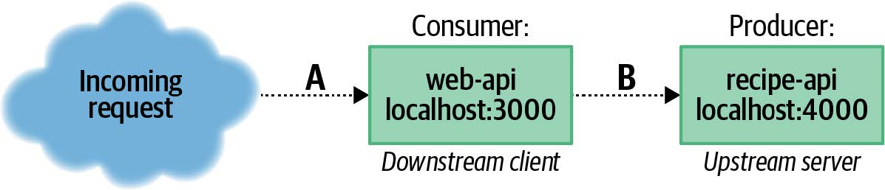
1. Create Project Structure [4]
mkdir recipe-api
cd recipe-api
npm init -y
cd ..
mkdir web-api
cd web-api
npm init -y
cd ..
mkdir shared

Slide 32
GraphQL Schema
A GraphQL schema is a string that describes all the interactions a particular GraphQL server is able to make.
It also describes all the objects a server can represent, as well as the types of those objects (such as String and Int).
There are essentially two classifications of these types; a type is either a primitive or it is a named object.

Slide 33
2. Create shared/graphql-schema.gql
type Query {
recipe(id: ID): Recipe
pid: Int
}
type Recipe {
id: ID!
name: String!
steps: String
ingredients: [Ingredient]!
}
type Ingredient {
id: ID!
name: String!
quantity: String
}

Slide 34
3. Create recipe-api/recipe-api.js (I)
#!/usr/bin/env node
// npm install fastify mercurius
const server = require('fastify')();
const mercurius = require('mercurius');
const path = require('path');
const fs = require('fs');
const schema = fs.readFileSync(path.join(__dirname,
'..', 'shared', 'graphql-schema.gql')).toString();
//console.log(schema);
const HOST = process.env.HOST || '127.0.0.1';
const PORT = process.env.PORT || 4000;

Slide 35
3. Create recipe-api/recipe-api.js (II)
The Query property describes the top-level queries.
Each property is an asynchronous method (methods that are awaited somewhere else in the code).
That means these methods can return a promise, they can be an async function, or they can just return a simple value.
const resolvers = {
Query: {
pid: () => process.pid,
recipe: async (_obj, { id }) => {
if (id != 42) throw new Error(`recipe ${id} not found`);
return {
id, name: "Chicken Tikka Masala",
steps: "Throw it in a pot...",
}
}
},

Slide 36
3. Create recipe-api/recipe-api.js (III)
The Recipe describes the Recipe objects.
Each property is an asynchronous method (methods that are awaited somewhere else in the code).
That means these methods can return a promise, they can be an async function, or they can just return a simple value.
Recipe: {
ingredients: async (obj) => {
return (obj.id != 42) ? [] : [
{ id: 1, name: "Chicken", quantity: "1 lb", },
{ id: 2, name: "Sauce", quantity: "2 cups", }
]
}
}
};

Slide 37
3. Create recipe-api/recipe-api.js (IV)
server
.register(graphql, { schema, resolvers, graphiql: true })
.listen(PORT, HOST, () => {
console.log(`recipe-api running at http://${HOST}:${PORT}/graphql`);
});

Slide 38
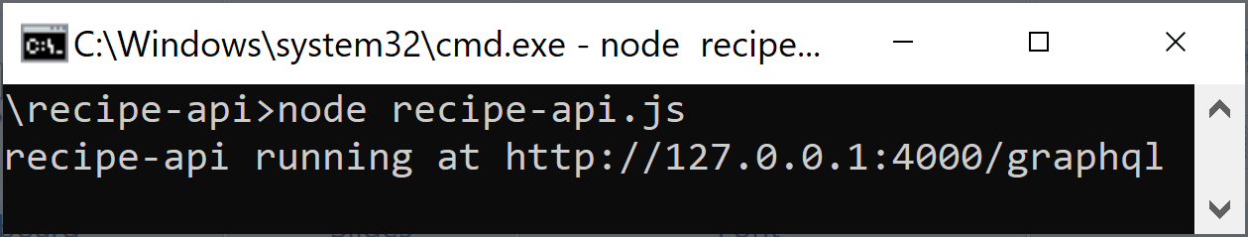
4. Run the recipe-api Service
cd recipe-api
npm install fastify mercurius
node recipe-api.js

Slide 39
5. Create web-api/web-api.js (I)
#!/usr/bin/env node
// npm install fastify node-fetch
const server = require('fastify')();
const fetch = require('node-fetch');
const HOST = '127.0.0.1';
const PORT = process.env.PORT || 3000;
const TARGET = process.env.TARGET || '127.0.0.1:4000';

Slide 40
5. Create web-api/web-api.js (II)
const complex_query = `query kitchenSink ($id:ID) {
recipe(id: $id) {
id name
ingredients {
name quantity
}
}
pid
}`;
The complex_query being sent is asking for almost every piece of data the server supports.
It names the query kitchenSink, which can be useful for debugging.
The arguments for the query are defined after the name, in this case it’s declared that there’s a variable named $id that is of type ID. That variable is then passed into the recipe() method.

Slide 41
5. Create web-api/web-api.js (III)
server.get('/', async () => {
const req = await fetch(`http://${TARGET}/graphql`, {
method: 'POST',
headers: { 'Content-Type': 'application/json' },
body: JSON.stringify({
query: complex_query,
variables: { id: "42" }
}),
});
return {
consumer_pid: process.pid,
producer_data: await req.json()
};
});
server.listen(PORT, HOST, () => {
console.log(`Consumer running at http://${HOST}:${PORT}/`);
});

Slide 42
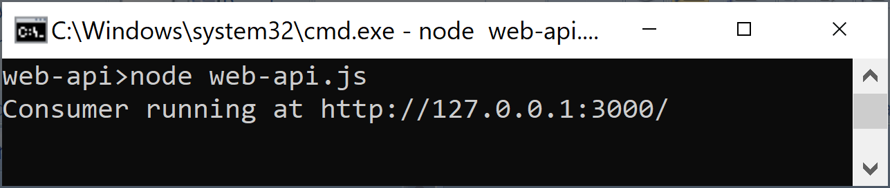
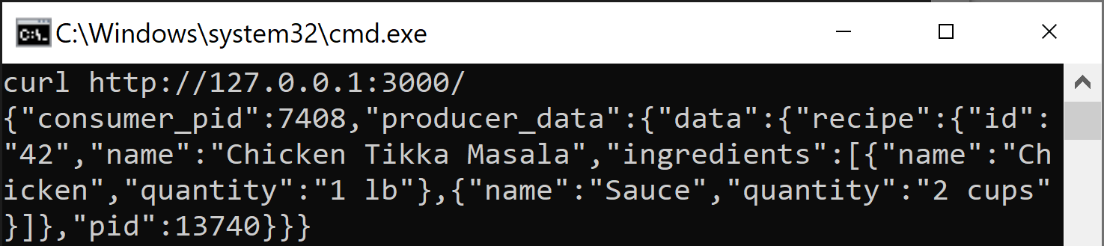
6. Run the web-api Service
cd web-api
npm install fastify node-fetch
node web-api.js
curl http://127.0.0.1:3000/

Slide 44
HTTP
https://graphql.org/learn/best-practices/
GraphQL is typically served over HTTP via a single endpoint which expresses the full set of capabilities of the service.

Slide 45
JSON (with GZIP)
GraphQL services typically respond using JSON, however the GraphQL spec does not require it.

Slide 46

Thank You & See You Again

